Slide 1


EPL 421: Systems Programming The Extensible Messaging and Presence Protocol
Nikolas Venizelou (nveniz01@ucy.ac.cy)

Slide 2
What does XMPP stands for
X – eXtensible
Design to grow and accommodate change
M – Messaging
Instant messaging between clients
P – Presence
Indicator that tells the servers that you are online/offline/busy
P – Protocol
Is a protocol, set of standard to allow systems to talk to each other

Slide 3

An Overview
A set of open technologies for instant messaging, presence, multi-party chat, voice and video calls, collaboration, lightweight middleware, content syndication, and generalized routing of XML data.
Created by Jeremie Miller in 1998 and developed in the Jabber open-source community. It was later named as XMPP
Meant to provide a free (as in freedom), open, decentralized alternative to the close instant messaging services at that time

Slide 4
Advantages
Open
Public and easily understandable, multiple implementations in clients, servers, components and libraries
Standard
the Internet Engineering Task Force (IETF) has formalized the core XML streaming protocols as an approved instant messaging and presence technology. RFCs and standardize Extensions
Secure
TLS, SASL and E2E encryption
Proven
Stable, thousands of servers, used by big tech companies (ex. Google talks)
Decentralized
Architecture similar to email, anyone can run their own server
Extensible & Flexible
Anyone can build a custom functionality, many extensions available, applications beyond IM
Notes:
TLS = Transport layer security
SASL = Simple Authentication and Security Layer (SASL) is a framework for authentication and data security in Internet protocol

Slide 5
Key XMPP technologies
Other than the Core technologies:
Jingle:
Provide clients to create / destroy multimedia sessions (ex. Video chat, Voice chat, file transfers)
Multi-User Chat:
Enables an IRC like multi-party communication
PubSub:
Enables publish subscriber functionality that is payload agnostic
BOSH :
Bidirectional-streams Over Synchronous HTTP
Notes:
bosh

Slide 6
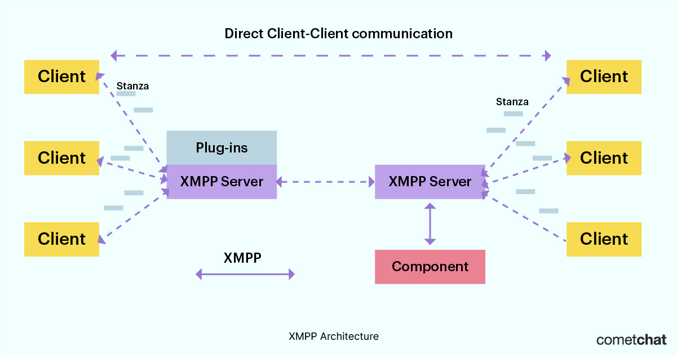
Architecture
Notes:
XMPP components are standalone entities that operate independently of the main XMPP server, while XMPP plug-ins are small modules that run within the main XMPP server and extend its functionality.

Slide 7
How does XMPP finds other Servers
Short answer: DNS
Long answer:
When a user sends a message to a recipient on another server, the XMPP server first looks up the domain name of the recipient's server using the DNS.
The DNS returns an IP address of the recipient's server.
Once the IP address is obtained, the XMPP server can establish a TCP/IP connection with the remote XMPP server
XMPP JID:
Unique identifier for each user, They usually take the form user@domain in a similar way to email addresses.

Slide 8
XMPP Stanzas
XML elements used in the XMPP protocol to exchange messages between two or more entities (such as clients, servers, and bots). There are three main types of XMPP stanzas:
Message stanzas
Presence Stanzas
IQ Stanzas

Slide 9
Message Stanza
Used to exchange messages between two or more XMPP entities, such as instant messages or chat room messages. The content of the message stanza may include text, images, and other data.
<message to='user@example.com’ from='anotheruser@example.com’>
<body>Hello!</body>
</message>

Slide 10
Present Stanza
These are used to signal the presence of an entity to other entities, such as whether they are online, offline, or busy. Presence stanzas can also include information about the entity's status, such as their mood, activity, or location.
<presence to='user@example.com' from='anotheruser@example.com’>
<status>Available</status>
<show>chat</show>
</presence>
Notes:
This stanza is used to indicate the presence status of a user. The <status> element provides a text description of the user's status, and the <show> element indicates whether the user is available, busy, away, or otherwise unavailable.

Slide 11
IQ Stanza
These are used to exchange data and control information between XMPP entities. IQ stanzas can be used for tasks such as authentication, roster management, and service discovery.
<iq type='get' to='domain.com’>
<query xmlns='http://jabber.org/protocol/disco#info’/>
</iq>
Notes:
This stanza is used to request information from a server or another client. In this example, the client is requesting information about the capabilities of the server using the disco#info namespace.

Slide 12
Client-Server Demo (1) - Info
A simple client to client message exchange using 2 XMPP Clients and a Server, in-order to showcase the message exchange between the clients and the server
XMPP Client implementation: Profanity (CLI XMPP client)
XMPP Server implementation: Openfire

Slide 13
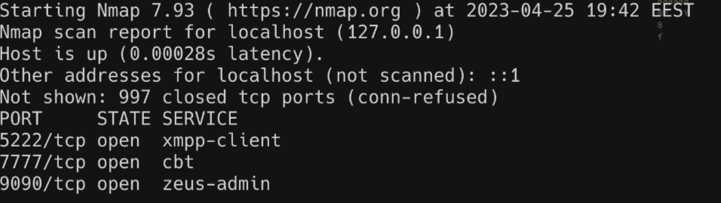
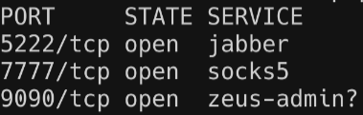
Client-Server Demo (2) - Openfire
XMPP server implementation written in Java
Has many extensions out of the box but we will focus on the core functionalities
Uses an embedded HSQL database
Chose to install using docker for faster deployment
docker run --name openfire -d --restart=always \
--publish 9090:9090 --publish 5222:5222 --publish 7777:7777 \
--volume /srv/docker/openfire:/var/lib/openfire \
nasqueron/openfire:4.7.4

Slide 14
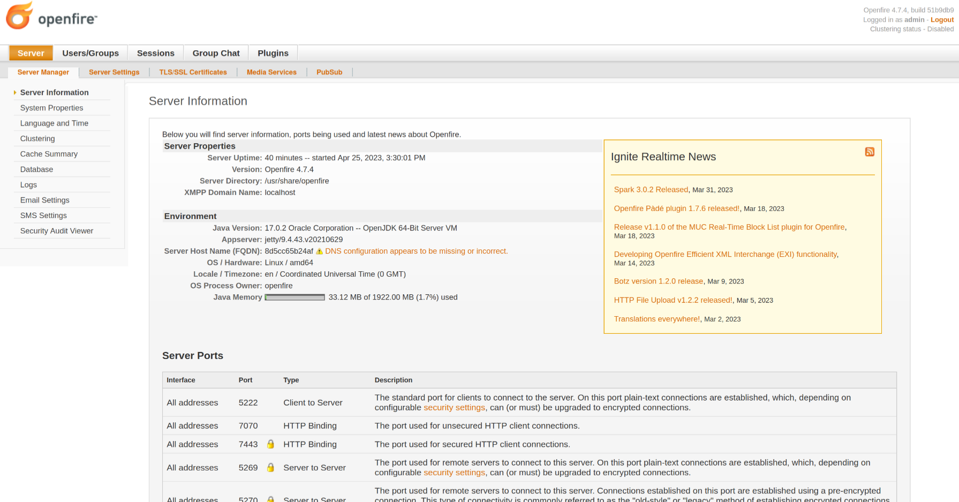
Client-Server Demo (3) – Openfire Admin panel

Slide 15
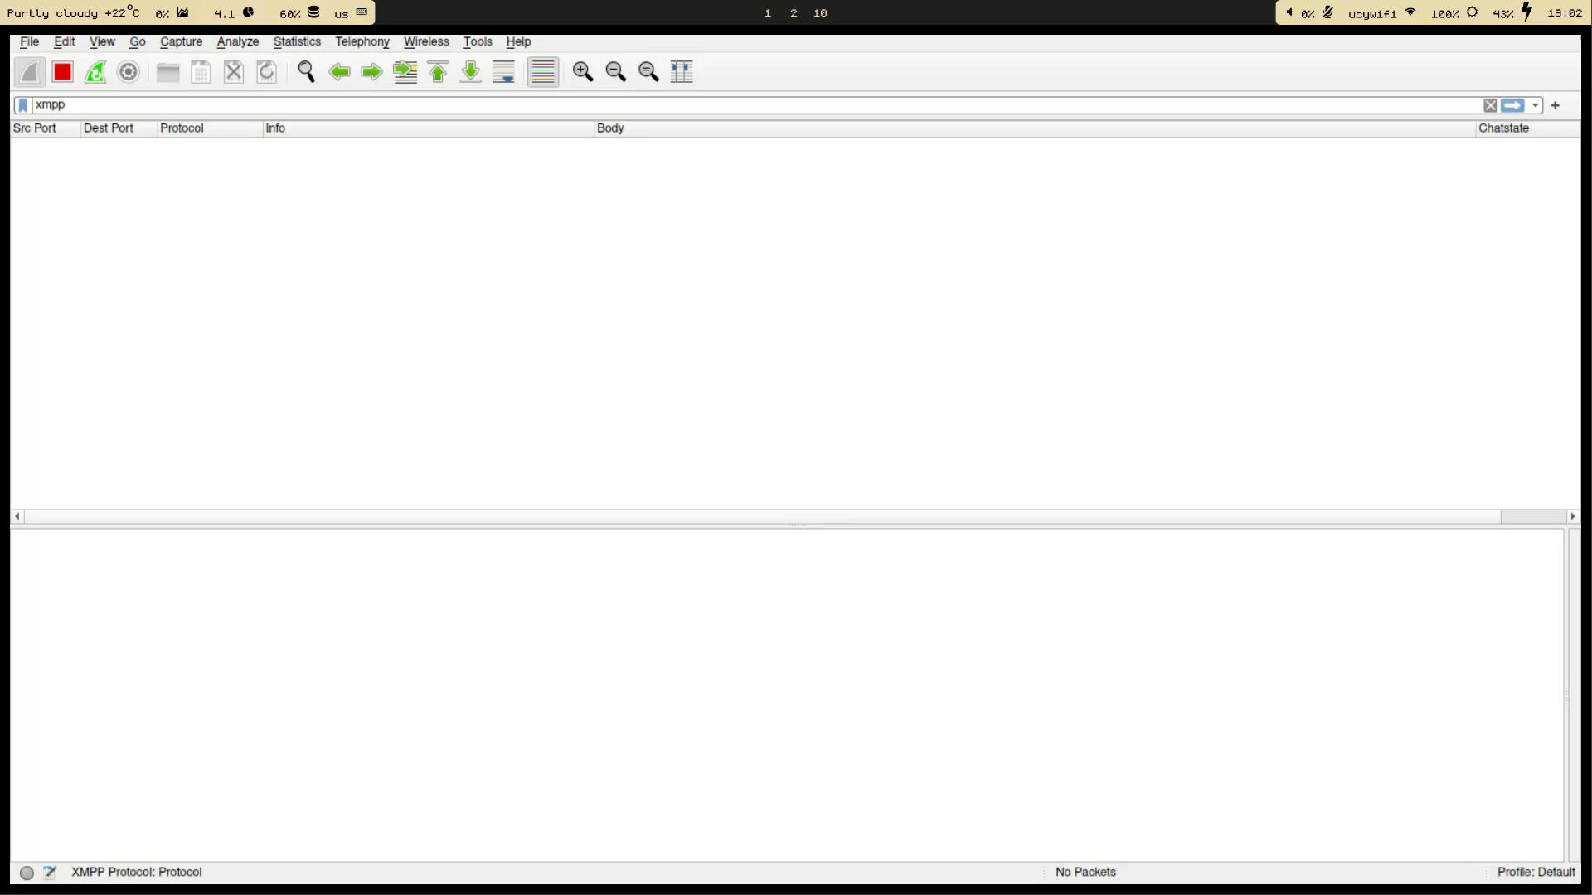

Slide 16
Thank you for your attention!
Questions?

Slide 17
Sources
https://github.com/igniterealtime/Openfire/tree/main/xmppserver
https://github.com/nasqueron/docker-openfire
https://github.com/profanity-im/profanity
https://en.wikipedia.org/wiki/XMPP
https://xmpp.org/about/technology-overview/
https://www.cometchat.com/blog/xmpp-extensible-messaging-presence-protocol

